Slide 1
Breakout Modeling
Product: 33182
Spartanburg Line 3
Nov. 30, 2014-Feb. 7, 2015
Trent Logan

Slide 2
Agenda
Overview
Model Results
Summary
Next Steps

Slide 3
Overview
Dataset comprised of product 33182
  Nov. 2014 - Feb. 2015
  6 runs
Inputs
  Process variables up to laydown
Output
  Breakouts

Slide 4
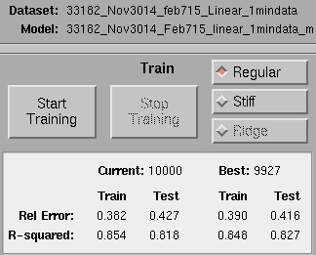
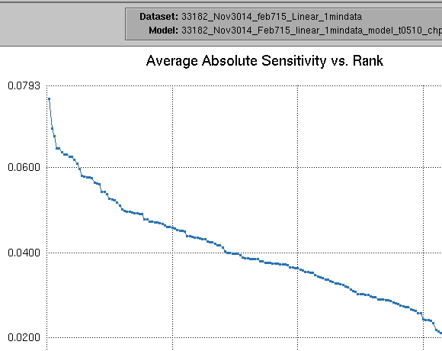
Model Results
Linear Time merge with breakout data.
  T0, T-5, T-10 CHP T-20, T-25, T-30
  Highlighted areas = highest interest
Linear | tau
Polymer Filter Zone #4 Temperature (Old A3394) | -10
Spin Beam Zone 6 Temperature (Old A3264) | -5
Spin Beam Zone 4 Temperature (Old A3262) | -10
Spin Beam Zone 2 Temperature (Old A3260) | 0

Slide 5
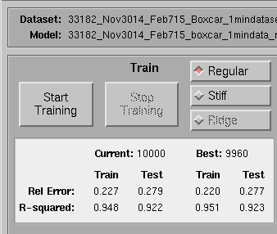
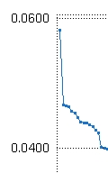
Model Results
Boxcar time merge with breakout data.
  T0, T-5, T-10 CHP T-20, T-25, T-30
  Highlighted areas = highest interest
Boxcar | tau
Spin Beam Zone 6 Temperature (Old A3264) | -10
Polymer Filter Zone #2 Temperature (Old A3392) | 0
Polymer Filter Zone #4 Temperature (Old A3394) | -10
Quench Air Drybulb Temperature (Old A3275) | -5
Spin Beam Zone 6 Temperature (Old A3264) | -5

Slide 6
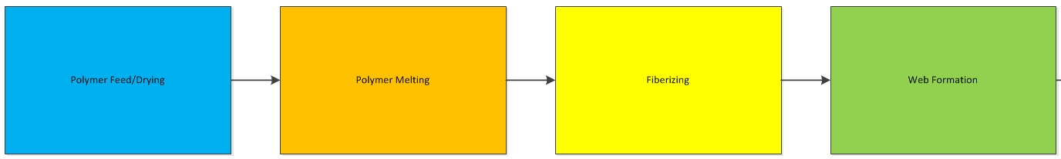
Modeling Overview-Process Area
All SPT models, all lines, historical
04115L | 04115B | 040090L | 040090B | 040090L2 | 040090B2 | 33182L | 33182B
Polymer Pack Pressure Core Beam 7-8 End T-5 | Quench Air Duct Dewpoint Relative Humidity T0 | Chip Dryer Air Temperature T-10 | Chip Dryer Scraper Level Control T-5 | Polymer Pack Pressure Core Beam 7-8 Mid T0 | Chip Dryer Scraper Level Control T-40 | Polymer Filter Zone #4 Temperature (Old A3394) T-10 | Spin Beam Zone 6 Temperature (Old A3264) T-10
Polymer Pack Pressure Core Beam 5-6 Mid T0 | Chip Dryer Scraper Level Control T0 | Chip Dryer Scraper Level Control T0 | Chip Dryer Exit Air Temperature T-5 | Chip Dryer Scraper Level Control T-50 | Polymer Pack Pressure Core Beam 7-8 Mid T0 | Spin Beam Zone 6 Temperature (Old A3264) T-5 | Polymer Filter Zone #2 Temperature (Old A3392) T0
Quench Air Inlet Air Temperature T0 | Chip Dryer Exit Air Temperature T0 | Chip Dryer Exit Air Temperature T0 | Chip Dryer Exit Air Temperature T0 | Chip Dryer Scraper Level Control T-40 | Chip Dryer Scraper Level Control T-50 | Spin Beam Zone 4 Temperature (Old A3262) T-10 | Polymer Filter Zone #4 Temperature (Old A3394) T-10
Quench Air Duct Dewpoint Relative Humidity T0 | Polymer Pack Pressure Core Beam 5-6 Mid T-5 | Polymer Beam Pressure Core Beam 5-6 End T0 | Chip Dryer Scraper Level Control T-10 | Chip Dryer Scraper Level Control T-45 | Chip Dryer Exit Air Temperature T-50 | Spinning West Inlet Maniflod Temperature (Old A3252) T-5 | Quench Air Drybulb Temperature (Old A3275) T-5
Polymer Pack Pressure Core Beam 7-8 Mid T0 | Dowtherm Vacuum Primary Pressure T-5 | Chip Dryer Air Temperature T0 | Chip Dryer Scraper Level Control T0 | Polymer Pack Pressure Core Beam 7-8 Mid T-20 | Chip Dryer Dry Air Chill Water Inlet Temp T-45 | Spin Beam Zone 2 Temperature (Old A3260) T0 | Spin Beam Zone 6 Temperature (Old A3264) T-5
Polymer Pack Pressure Core Beam 5-6 Mid T-5 | Chip Hopper Exit Temperature T-5 | Polymer Pack Pressure Core Beam 7-8 Mid T-5 | Polymer Beam Pressure Core Beam 5-6 End T-10 | Chip Dryer Dry Air Chill Water Inlet Temp T-45 | Chip Dryer Exit Air TemperatureT-40 | Extruder Zone 3 Temperature (Old A3237) T0 | STP003CHP_TI212 Chip Dryer Chip Temperature (Old A3227) T-20
Chip Dryer Inlet Air Pressure T0 | Chip Dryer Exit Air Temperature T-5 | Stretch Nozzle Air Pressure T-5 | Chip Dryer Air Temperature T-5 | Polymer Pack Pressure Core Beam 7-8 Mid T-5 | Polymer Beam Pressure Core Beam 5-6 End T0 | Spin Beam Zone 6 Temperature (Old A3264) T-10 | Spin Beam Zone 7 Temperature (Old A3253) T-10
Polymer Beam Pressure Sheath Beam 5-6 End T-5 | Polymer Pack Pressure Core Beam 7-8 Mid T0 | Chip Dryer Air Temperature T-5 | Polymer Pack Pressure Core Beam 7-8 Mid T0 | Polymer Beam Pressure Core Beam 5-6 End T0 | Chip Dryer Inlet Air Pressure T-40 | Polymer Filter Zone #4 Temperature (Old A3394) T0 | Polymer Filter Zone #4 Temperature (Old A3394) T-5
Polymer Pack Pressure Core Beam 7-8 End T0 | Polymer Pack Pressure Core Beam 5-6 Mid T0 | Chip Dryer Dry Air Chill Water Inlet Temp T-5 | Polymer Pack Pressure Core Beam 7-8 Mid T-5 | Chip Dryer Dry Air Chill Water Inlet Temp T-50 | Chip Dryer Scraper Level Control T-45 | Extruder Zone 5 Temperature (Old A3239) T-5 | Pre-Spin Pump Pressure (Old A3280) Selectible PV for EXT_PIC101 T-5
Dowtherm Vacuum Primary Pressure T-5 | Polymer Beam Pressure Sheath Beam 5-6 End T0 | Chip Dryer Exit Air Temperature T-10 | Spinning West Inlet Manifold Temperature T0 | Sheath Chip Dryer Air Temperature T-20 | Chip Dryer Inlet Air Flow Differential T-40 | Spin Beam Zone 5 Temperature (Old A3263) T-10 | Polymer Filter Zone #3 Temperature (Old A3393) T0

Slide 7
Line 3 Modeling Overview-Process Area
33182L | 33182B
Polymer Filter Zone #4 Temperature (Old A3394) T-10 | Spin Beam Zone 6 Temperature (Old A3264) T-10
Spin Beam Zone 6 Temperature (Old A3264) T-5 | Polymer Filter Zone #2 Temperature (Old A3392) T0
Spin Beam Zone 4 Temperature (Old A3262) T-10 | Polymer Filter Zone #4 Temperature (Old A3394) T-10
Spinning West Inlet Maniflod Temperature (Old A3252) T-5 | Quench Air Drybulb Temperature (Old A3275) T-5
Spin Beam Zone 2 Temperature (Old A3260) T0 | Spin Beam Zone 6 Temperature (Old A3264) T-5
Extruder Zone 3 Temperature (Old A3237) T0 | STP003CHP_TI212 Chip Dryer Chip Temperature (Old A3227) T-20
Spin Beam Zone 6 Temperature (Old A3264) T-10 | Spin Beam Zone 7 Temperature (Old A3253) T-10
Polymer Filter Zone #4 Temperature (Old A3394) T0 | Polymer Filter Zone #4 Temperature (Old A3394) T-5
Extruder Zone 5 Temperature (Old A3239) T-5 | Pre-Spin Pump Pressure (Old A3280) Selectible PV for EXT_PIC101 T-5
Spin Beam Zone 5 Temperature (Old A3263) T-10 | Polymer Filter Zone #3 Temperature (Old A3393) T0

Slide 8
Summary
Both models trained well with high R² values >0.8.
Focus on those high ranking variables
Data suggests temperature is critical, linked to viscosity
Next steps- plant requests
Results are valid for the dataset tested and may vary with new or subsequent datasets.

